Slide 1
Text in Databases Charles Severance www.pg4e.com/lectures/04-Text.sql

Slide 2
Character Sets https://www.py4e.com/lessons/network

Slide 3
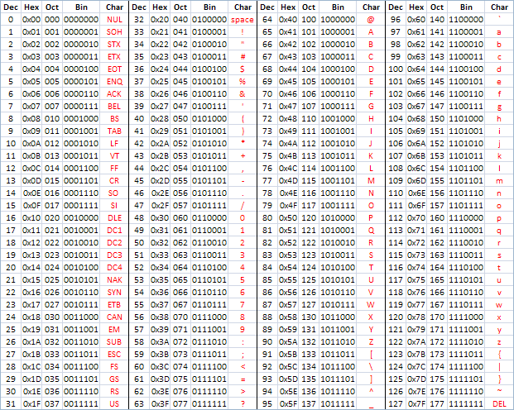
ASCII
American Standard Code for Information Interchange
https://en.wikipedia.org/wiki/ASCII
http://www.catonmat.net/download/ascii-cheat-sheet.png

Slide 4
Representing Simple Strings
"In the old days" - each character is represented by a number between 0 and 127 stored in 8 bits of memory
We refer to "8 bits of memory as a "byte" of memory
The ascii() function tells us the numeric value of a single ASCII character
The chr() function maps from an integer to a character
discuss=> select ascii('H'), ascii('e'), ascii('l'), chr(72), chr(42);
ascii | ascii | ascii | chr | chr
-------+-------+-------+-----+-----
72 | 101 | 108 | H | *

Slide 5
discuss=> select ascii('H'), ascii('e'), ascii('l'), chr(72), chr(42);
ascii | ascii | ascii | chr | chr
-------+-------+-------+-----+-----
72 | 101 | 108 | H | *
In the 1960s and 1970s, we just assumed that one byte was one character

Slide 6
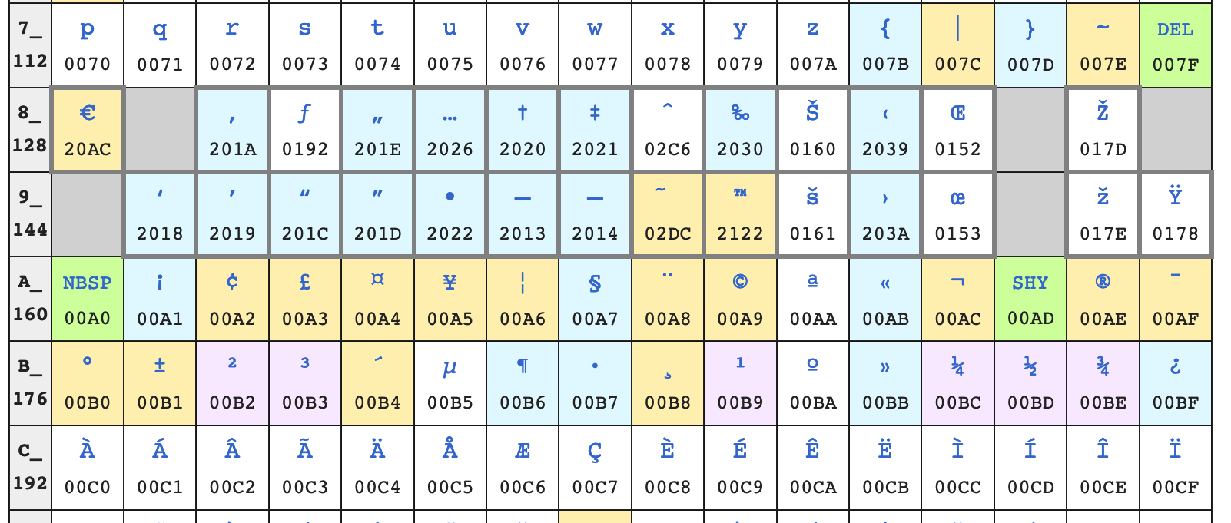
Beyond 127…
To be "more international" they defined characters 128-255 but inconsistently
https://en.wikipedia.org/wiki/ISO/IEC_8859-1 (latin1)
https://en.m.wikipedia.org/wiki/Windows-1252
Don't cut and paste code or text from PDFs ☹

Slide 7
To be even more international
We needed more than 128 new characters globally so 128-255 could mean different things based on context
ISO 8859-2 for Eastern European languages
ISO 8859-3 for Turkish, Maltese and Esperanto
ISO 8859-5 for Cyrillic
But these were not self-documenting you needed to know the character set outside the data of the file ---- Confusion

Slide 8
Unicode – All Characters in One Set
Unicode is 32 / 21 bits (long story)
Unicode 12.1
137,000 characters
150 character sets
discuss=> select chr(72), chr(231), chr(20013);
chr | chr | chr
-----+-----+-----
H | ç | 中
https://en.wikipedia.org/wiki/List_of_Unicode_characters

Slide 9
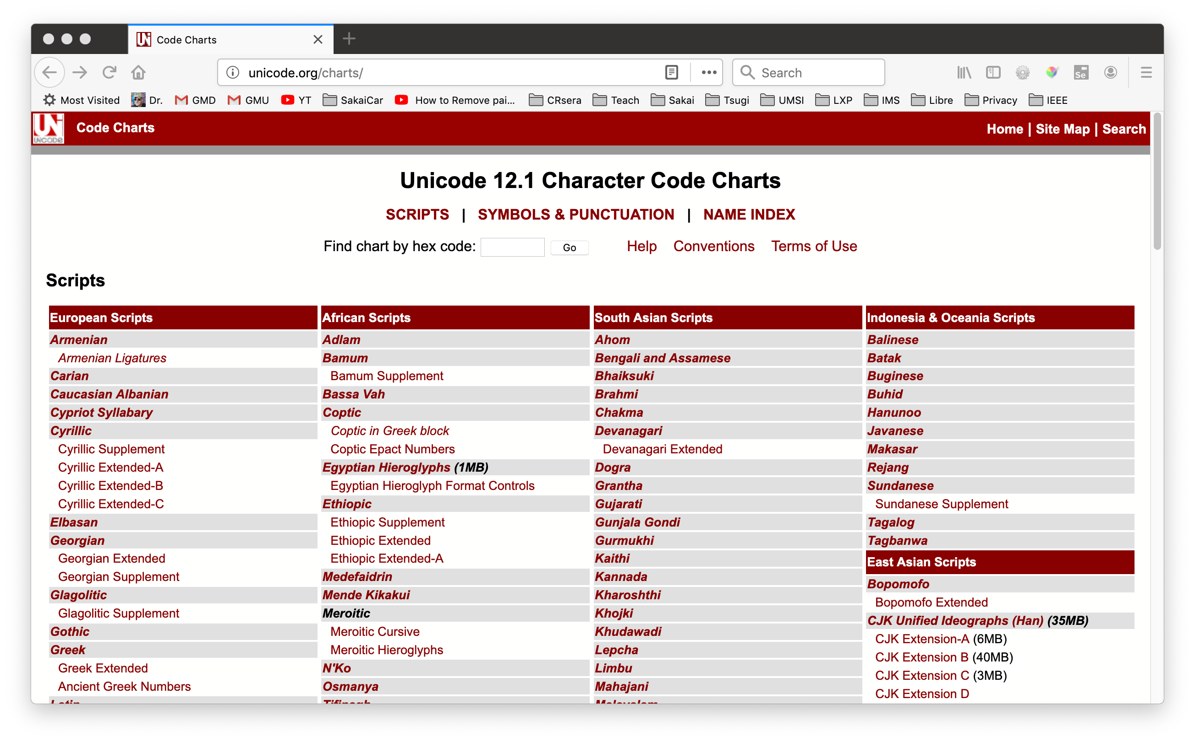
http://unicode.org/charts/

Slide 10
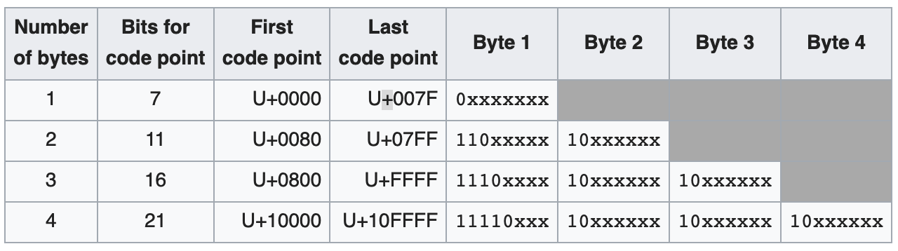
We can't afford 32 bit characters
UTF-8 is a compression scheme for Unicode
Represents 21 bits in 8-32 bits
0-128 are ASCII
128-255 are signals
https://en.wikipedia.org/wiki/UTF-8

Slide 11
UTF-8 In Transition
ASCII is UTF-8 / No Conversion
Partial auto convert of
Latin-1
1252

Slide 12
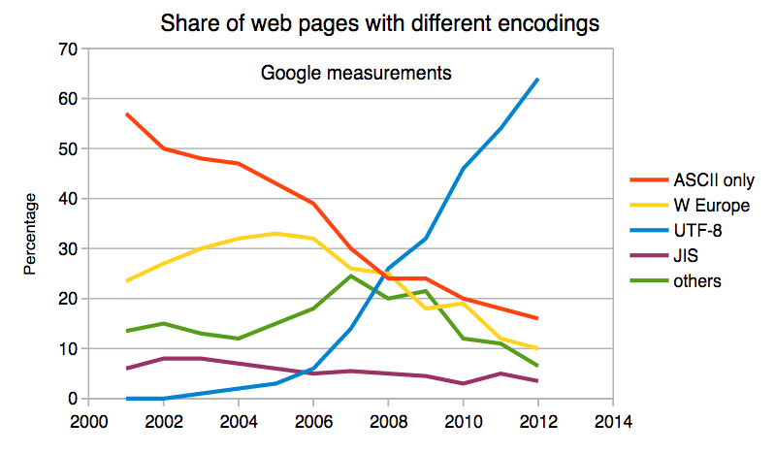
UTF-8 Is Dominant
UTF-8 is 94% of all web pages in 2019
https://w3techs.com/technologies/details/en-utf8/all/all

Slide 13
Character Sets In Python https://www.py4e.com/lessons/network

Slide 14
Python 3 and Unicode
Strings in memory are Unicode
The "bytes" type is for 8-bit characters
Strings "at rest" are generally stored UTF-8 for space and interoperability
Files
Network resources
Database tables
>>> x = b'abc'
>>> type(x)
<class 'bytes'>
>>> x = '이광춘'
>>> type(x)
<class 'str'>
>>> x = u'이광춘'
>>> type(x)
<class 'str'>

Slide 15
PYTHON
UNICODE
UTF-8 NETWORK
DATA
DECODE
UTF-8 FILE
DATA
DECODE
ENCODE
ENCODE
UTF-8
DATABASE
DATA
DECODE
ENCODE

Slide 16
Opening a File
open(file, mode='r', buffering=-1,
encoding=None, errors=None, newline=None,
closefd=True, opener=None)
encoding is the name of the encoding used to decode or encode the file. This should only be used in text mode. The default encoding is platform dependent (whatever locale.getpreferredencoding() returns), but any text encoding supported by Python can be used. See the codecs module for the list of supported encodings.
https://docs.python.org/3/library/functions.html#open

Slide 17
Reading Network Data
When we read data from an network resource, we must decode it based on the character set so it is properly represented in Python 3 as a UNICODE string
while True:
data = mysock.recv(512)
if ( len(data) < 1 ) :
break
mystring = data.decode()
print(mystring)

Slide 18
Database Data
When you interact with a database from Python all conversion between Unicode and UTF-8 is done implicitly
The Python database connector (i.e. psycopg2) knows the internal storage format of the database and automatically handles all conversion

Slide 19
Inside Hashes

Slide 20
A hash function is any function that can be used to map data of arbitrary size onto data of a fixed size.
https://en.wikipedia.org/wiki/Hash_function

Slide 21
Uses of Hashes
Checksum – see if a message was altered in transit
Cryptography / Signature – See if a message came from a trusted source
Enable fast lookup of data
Python dictionaries
Database tables

Slide 22
Good Hash Functions
Deterministic – There can be no randomness – must get the same output for the same input
Uniform Distribution – Should have an equal chance of generating any value with the range of its outputs – values don't cluster or collide
Sensitive – Any change in input should provide a change in output
One-way – You should not be able to derive the input from the output

Slide 23
Special Math for Hash Computation
Bitwise operators
<< left shift
^ Exclusive or
& And
https://www.pg4e.com/code/hashmath.py
x = 15
y = ord('H')
print('x', x, format(x, '08b'))
print('y', y, format(y, '08b'))
print('x^y ', format(x^y, '08b'));
print('x&y ', format(x&y, '08b'));
print('x<<1', format(x<<1, '08b'));
$ python3 hashmath.py
x 15 00001111
y 72 01001000
x^y 01000111
x&y 00001000
x<<1 00011110

Slide 24
$ python3 simplehash.py
Enter a string: Hello
H 01001000 1001000 072 72
e 01100101 11110101 101 245
l 01101100 110000110 108 390
l 01101100 1101100000 108 864
o 01101111 11010101111 111 1711
000006af 1711
Enter a string: hello
h 01101000 1101000 104 104
e 01100101 10110101 101 181
l 01101100 100000110 108 262
l 01101100 1001100000 108 608
o 01101111 10010101111 111 1199
000004af 1199
Enter a string: ehllo
e 01100101 1100101 101 101
h 01101000 10100010 104 162
l 01101100 100101000 108 296
l 01101100 1000111100 108 572
o 01101111 10000010111 111 1047
00000417 1047
while True:
txt = input("Enter a string: ")
if len(txt) < 1: break
hv = 0;
for let in txt:
hv = ((hv << 1) ^ ord(let)) & 0xffffff;
if ( hv < 2000 ) :
print(let,
format(ord(let), '08b'),
format(hv,'16b'),
format(ord(let), '03d'), hv)
print(format(hv, '08x'), hv)
https://www.pg4e.com/code/simplehash.py

Slide 25
The Science/Math of Hashing
Designing Hash Computations is serious work
National Institute of Standards and Technology (NIST) runs multi-year "competitions" when new hashing algorithms are needed
Sometimes algorithms have flaws that are detected years later and we deprecate them

Slide 26
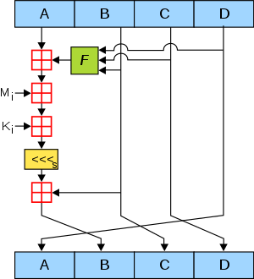
The "Classic" Hash - MD5
128 bit hash
Widely implemented
Broken for cryptography
Can alter data in transit without breaking a signature
Rainbow tables use forward computation and storage to reverse MD5 for short input strings (Password hashing)
https://en.wikipedia.org/wiki/MD5

Slide 27
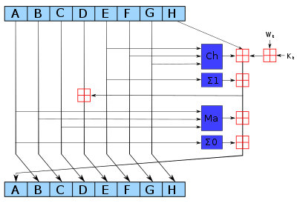
SHA-256 – A Modern Hash
A family of related hashes called "SHA-2"
Created with NIST in 2001
md5('hello') = 5d41402abc4b2a76b9719d911017c592
sha256('hello') = 2cf24dba5fb0a30e26e83b2ac5b9e29e1b161e5c1fa7425e73043362938b9824

Slide 28
Generating Test Data

Slide 29
Concatenation ||
Repeat (horiz)
generate_series() vertical

Slide 30
Indexes and Performance

Slide 31
Date Types (Review)
DATE - 'YYYY-MM-DD'
TIME - 'HH:MM:SS'
TIMESTAMP - 'YYYY-MM-DD HH:MM:SS' (4713 BC, 294276 AD)
TIMESTAMPZ – "TIMESTAMP WITH TIME ZONE"
Built-in PostgreSQL function NOW()

Slide 32
Strings

Slide 33
Concatenation ||
Repeat (horiz)
generate_series() vertical

Slide 34
Reducing the result set
DISTINCT only returns unique rows in a result set – and row will only appear once
DISTINCT ON limits duplicate removal to a set of columns
GROUP BY is combined with aggregate functions like COUNT(), MAX(), SUM(), AVE() …

Slide 35
Sub-Queries

Slide 36
A query within an query
Can use a value or set of values in a query that are computed by another query
SELECT * FROM account
WHERE email='ed@umich.edu';
SELECT content FROM comment
WHERE account_id = 7;
SELECT content FROM comment
WHERE account_id = (SELECT id FROM account WHERE email='ed@umich.edu');

Slide 37
Concurrency

Slide 38
Transaction Topics
Lock strength UPDATE, NO KEY UPDATE
What to do when encountering a lock (WAIT), NOWAIT, SKIP LOCKED

Slide 39
Stored Procedures

Slide 40
Stored Procedures
A stored procedure is a bit of reusable code that runs inside of the database server
Technically there are multiple language choices but just use "plpgsql"
Generally quite non-portable
Usually the goal is to to have fewer SQL statements

Slide 41
Summary

Slide 42
https://www.postgresql.org/docs/11/sql-select.html
SELECT [ ALL | DISTINCT [ ON ( expression [, ...] ) ] ]
[ * | expression [ [ AS ] output_name ] [, ...] ]
[ FROM from_item [, ...] ]
[ WHERE condition ]
[ GROUP BY grouping_element [, ...] ]
[ HAVING condition [, ...]
[ ORDER BY expression [ ASC | DESC | USING operator ]
[ LIMIT { count | ALL } ] [ OFFSET start [ ROW | ROWS ] ]
[ FOR { UPDATE | NO KEY UPDATE | SHARE | KEY SHARE }
[ OF table_name [, ...] ] [ NOWAIT | SKIP LOCKED ] [...] ]

Slide 43
Acknowledgements / Contributions
These slides are Copyright 2019- Charles R. Severance (www.dr-chuck.com) as part of www.pg4e.com and made available under a Creative Commons Attribution 4.0 License. Please maintain this last slide in all copies of the document to comply with the attribution requirements of the license. If you make a change, feel free to add your name and organization to the list of contributors on this page as you republish the materials.
Initial Development: Charles Severance, University of Michigan School of Information
Insert new Contributors and Translators here including names and dates
Continue new Contributors and Translators here

